Slide 1

Predicting Prices of Airbnb Listings
Team Members:
Nisarga Khairnar
Praharshita Kaithepalli
Professor: Dr. Nidhi Rastogi
Fall 21

Slide 2

DataSet
The company AirBNB will never release data sets from within their company.
This is an independent website that has data sets of AirBNB listings using the data that is available on their website for viewing of general public.
Dataset includes information about listings of NYC Airbnb last scraped on Nov 2nd 2020.
http://insideairbnb.com/get-the-data.html

Slide 3
DATA DESCRIPTION
Dataset contained the following columns
Listing description - Data describing listing information such as listing ID, listing URL, listing name, listing picture and neighbourhood overview.
Host description - Data describing the host.
For example - host ID, host URL, host name , host joining date, host location, host_is_superhost, host neighbourhood.
Host communication description - Data describing communication between host and its consumers. For example - host response time, host response rate, host acceptance rate

Slide 4
contd…
Listing area description - Data describing the neighbourhood and rooms of a listing, such as neighbourhood, neighbourhood_group, latitude, longitude, property type, room type, bathrooms, beds, amenities and accommodates.
Previous listing properties - Data describing the past properties of the listing for example - availability 30 ( describing how many days was the listing available in the last 30 day), availability 60, availability 90 and availability 365.
Listing review description - Data describing the listing reviews such as, rating, cleanliness, checkin, communication, location, value and reviews per month.

Slide 5
Processing the Data
A lot of important columns were in object data type.
Some columns values had extra characters, for example “2 bathrooms”,”1 bathroom shared” etc.
Had to replace columns which had true(t) or false(f) values with 0 and 1’s.
Created new columns such as “number_of_amenities” and “len_host_verifications”.
Some categorical features such as “room_type” we changed into numerical values using label encoder.
Filled all the missing values with median or some other value relevant to that feature.

Slide 6
DATA
VISUALIZATION

Slide 7
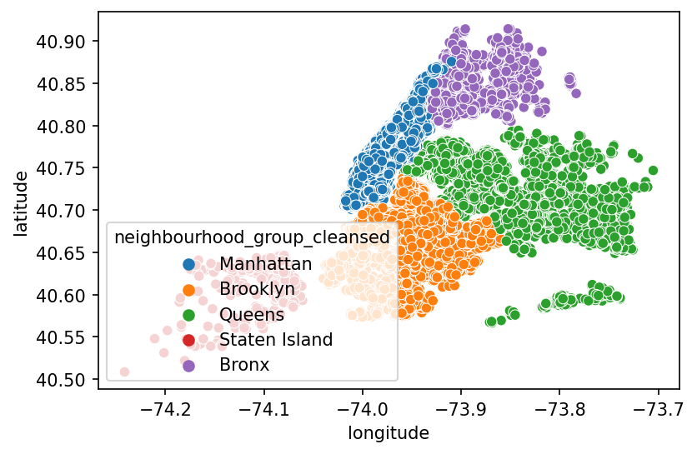
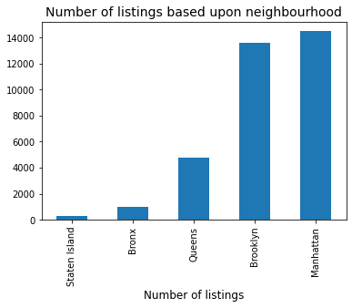
Listings w.r.t neighbourhoods in NYC
Notes:
We can see that most of the listings are present in Brooklyn and Manhattan area. As prices might depend on the neighborhood we will use one hot encoding to use the neighborhood values in the prediction.
We can see that many AirBNB listings are located in the Manhattan and Brooklyn area. We will use the 'neighbourhood_cleansed' column in the prediction as it is more specific that 'neighbourhood_group_cleansed'.

Slide 8
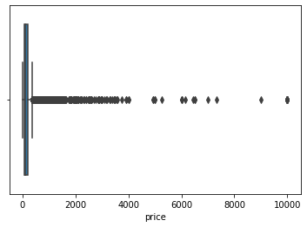
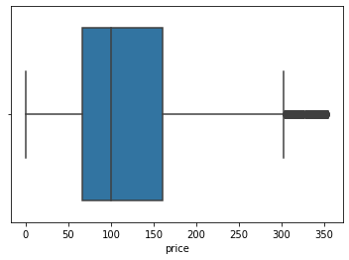
Outliers in the price
Box plots of the price feature before and after removing the outliers using Interquartile Range method.
Notes:
Even the visualization is a bit more accurate after the outliers are removed.

Slide 9
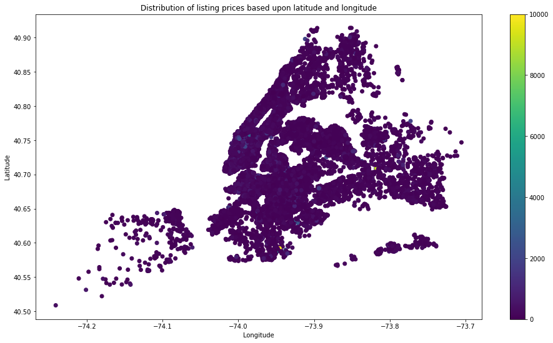
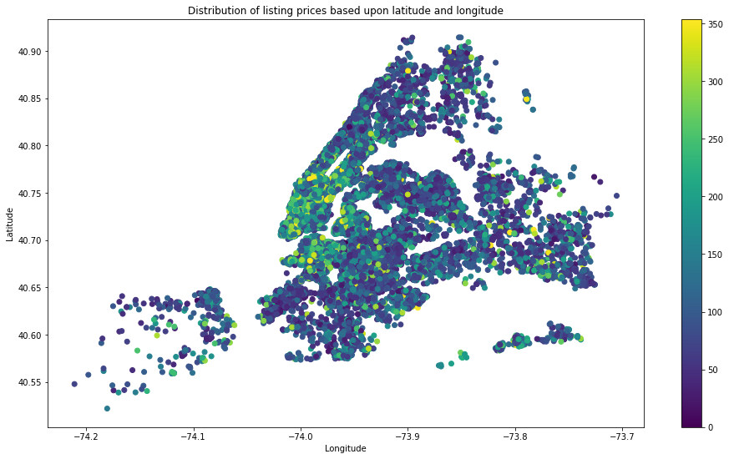
Price distribution plot
Price distribution plot wrt to latitude and longitude values before and after removing the outliers.
Notes:
This is a graph of price distribution after the outliers are removed

Slide 10
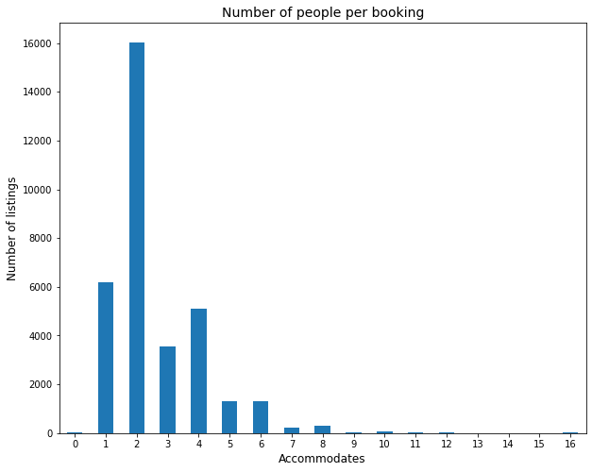
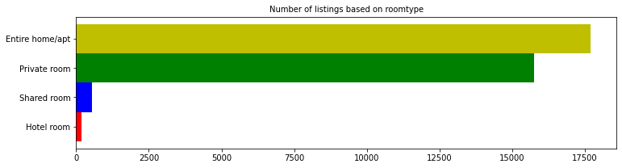
Some of the listing properties
Notes:
Based upon the above graph we can see that most listings are entire home/appartments. We will also use 'room_type' column in prediction by using one-hot encoding.

Slide 11
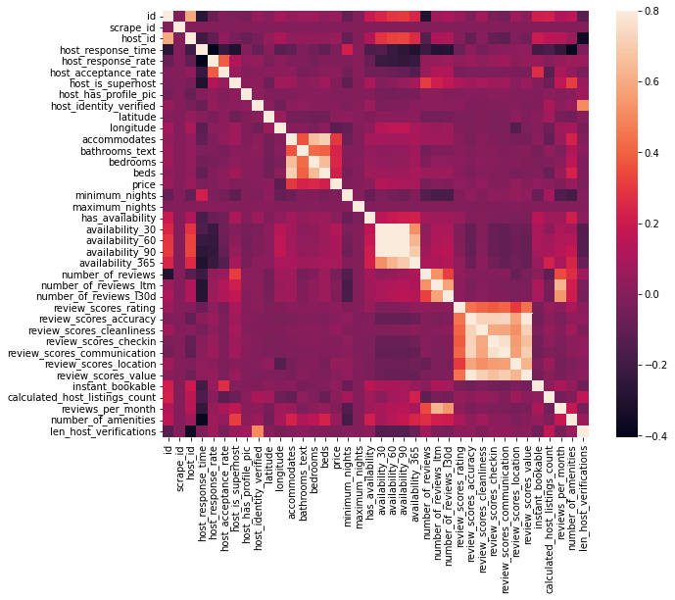
Correlation HeatMap
Notes:
We plot a heat map to see the co-relation between different features. We can see that some features like reviews_ltm , reviews_l30d and review_scores have too much corelation. We will create a single feature for reviews and we will drop all the other columns. We do the same with other features as well. We can also see that there is more correlation between price and the accommodates,bathrroms_text,bedrooms and beds columns.

Slide 12
Creating New Features

Slide 13
Three new features
df['review_score']=(df_listings['review_scores_rating']+df['review_scores_accuracy']+df['review_scores_checkin']+df['review_scores_cleanliness']+df['review_scores_communication']+df['review_scores_location']+df['review_scores_value'])/7
df['reviews_last_month']=(df['number_of_reviews_l30d']+df['number_of_reviews_ltm'])/2
df['host_importance'] = (((df['host_response_rate']/100)+df['host_listings_count']+df['host_identity_verified']+df['host_is_superhost']+df['len_host_verifications'])/5)*df['review_scores_communication']
As we saw in the above heatmap there were similar columns that had a lot of correlation. So we created new features and we dropped all the extra similar columns.
Notes:
Describe why u divided by 7 and column _l30d and _ltm are the samew as number of reviews last month but twice.

Slide 14
Encoding Categorical Features
Price of the AirBNB listing will depend on the neighborhood it is in and the type of the room.
But these columns are categorical values not numerical.
So we use the one hot encoding method to create various new features.
After creating the new features we drop the “neighbourhood_cleansed” and “room_type” columns.

Slide 15
Model Development
Metrics used -
R2 Score
Root Mean Square Error(RMSE)
Mean Square Error(MSE)
Mean absolute error(MAE)
Scoring -
To determine the accuracy of the model, model.accuracy() is not pragmatic to a consumer.
As the prices fluctuate with time, (for example, price hikes on major holidays), It is more practical to bucket the prices and score the model using those buckets.
We have used 35$ as the bucket size.

Slide 16
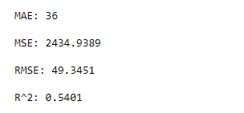
Linear Regression
Based upon the R-square value there is 54% fit in the regression model.
This is not much of a desired value, we could get a better prediction.
We will use other models to find and see if we get better accuracy
+/-35 - 62%

Slide 17
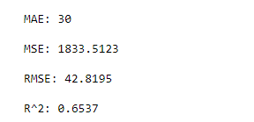
Random Forest Regression
Based upon the R-square value there is 65% fit in the regression model.
This is better prediction than the last model.
Again, we will use other models to find and see if we get better accuracy.
+/-35 : 69.8%
Notes:
Reason why rf performs better than others is because the dataset has a lot statistical noise.

Slide 18
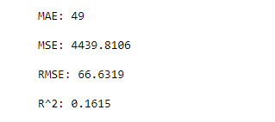
K-Neighbours Regression
KNN regression with the given dataset is resulting in an rmse value of 66 and a R2 score of 16%.
KNN regressor is not able to determine the variability of the features with respect to the output label. Reason for this outcome is the high statistical noise in the dataset as listings having similar properties have a huge difference in price.
+/-35 : 48%

Slide 19
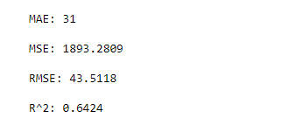
Gradient Boosting Regressor
Based upon the R-square value there is 64% fit in the regression model.
Prediction is better than some other models.
We will use other boosting models to find and see if we get better accuracy.
+/-35 : 68.6%

Slide 20
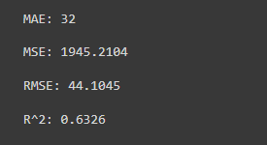
Light Gradient Boosting Regression
Based upon the R-square value there is 63% fit in the regression model.
Prediction is better than some other models.
We will use other models to find and see if we get better accuracy.
+/-35 : 68.2%

Slide 21
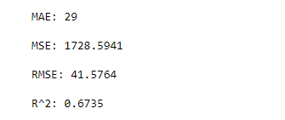
Extreme Gradient Boosting Regressor
Based upon the R-square value there is 67% fit in the regression model.
Prediction is better than all other models.
+/-35: 70.9%

Slide 22
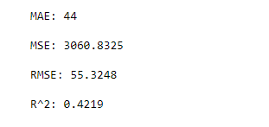
Adaboost Regressor
Based upon the R-square value there is 42% fit in the regression model.
Prediction is better than some other models.
+/-35 : 45.3%

Slide 23
Best Performing Model
The best performing model here was Extreme gradient boosting model .
It was able to predict 67% variance in prices, with an accuracy of 70.9%.
We perform hyper parameter training on XGB model.
Notes:
Num_boost_round
Max_depth
Min_child_weight
Subsample
Colsample_by tree
eta

Slide 24
Hyper Parameter Tuning.
In order to tune the other hyperparameters, we will use the cv function from XGBoost. It allows us to run cross-validation on our training dataset and returns a mean MAE score.
After training and tuning the hyper parameters this is the values we achieved:
n_estimators = 967
learning_rate = 0.08
gamma = 86
max_depth = 9
objective: 'reg:linear'
subsample: 1.0

Slide 25
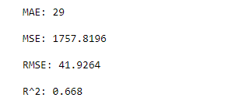
Hyper Parameter Tuning
Using Bayesian Hyper-Parameter tuning,
We got little low scores but noticed an increase in the accuracy.
Updated Scores are -
With updated accuracy - 71.3%

Slide 26
Conclusion
Like we saw earlier Extreme gradient boosting regressor was the better performing model.
We can notice that the prediction isn't accurate, with a score of 71% (+/-35)
There will be a few reasons as to why the prediction might not be accurate and this might be due to several other features that are not part of the current data set we are using.

Slide 27
Future Work and Recommendations
Instead of number of reviews, we could get information about the sentiment of the reviews.
We could also have feature where it shows the number of 5-star,4-star reviews etc.
There should be a proximity feature which shows the distance between major locations in and around the city, which will affect the pricing.
Accessibility and location benefits features will be desirable.
Even though properties are in same neighbourhood, their pricing will differ based upon different factors for example- old/new property.
A timeline of price trend could help predict the prices at major dates, such as holidays, new years, etc.

Slide 28
Thank you!

